Slide 1

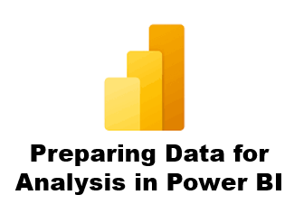



1 Introduction to Power BI
Prepared By :
Said Fawzy
Manager of Information Center
Tendering Department
Arab Contractors

Slide 2

1 Introduction to Power BI
Prepared By :
Said Fawzy
Manager of Information Center
Tendering Department
Arab Contractors

Slide 3

1
What is Power BI
2
Data Life Cycle
3
Business Intelligent Solution
4
Power BI Licenses

Slide 4
5
Download Power BI Desktop

Slide 5
1
What is Power BI

Slide 6
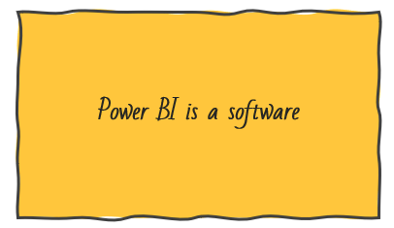




What is Power BI
Data Driven Decision Making

Slide 7


How is Power BI different from Excel?
Power BI allows rich, immersive and interactive experiences
Power BI works with large data sets.
Share and read reports easily.
Power BI is for story telling

Slide 8
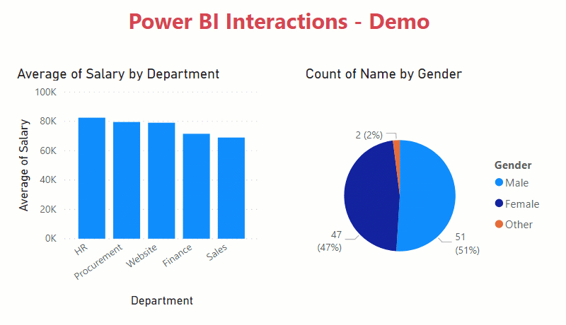
How is Power BI different from Excel?
Preparing Data for Analysis in Power BI

Slide 9
2
Data Life Cycle

Slide 10
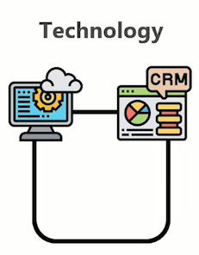


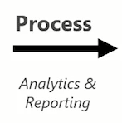
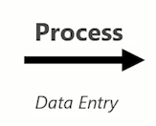
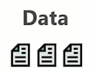

Data Life Sycle

Slide 11
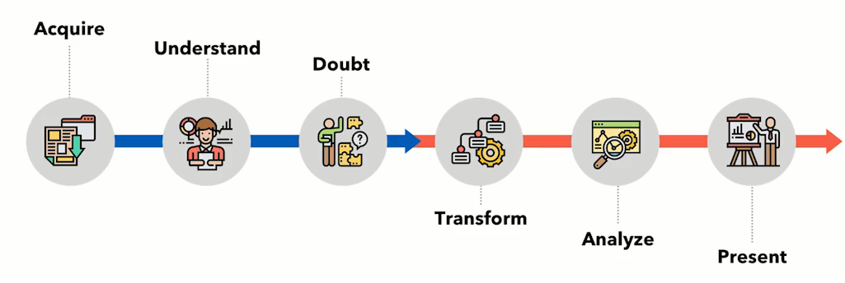

Analytics Process Flow

Slide 12
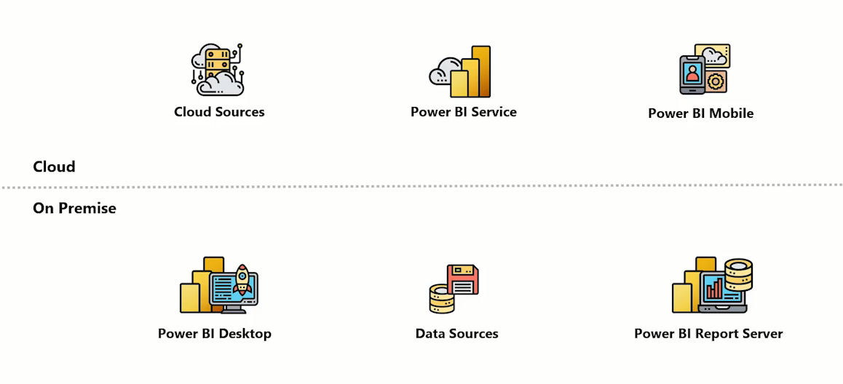
Power BI Architecture
Publish
Gateway

Slide 13
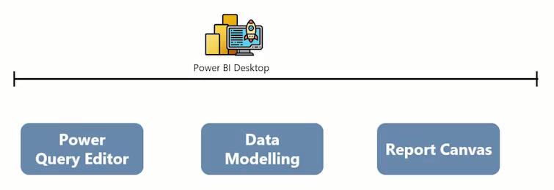
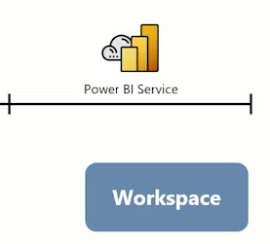
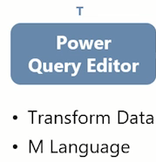
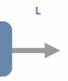
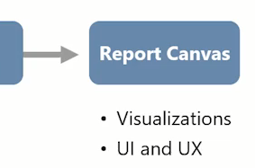

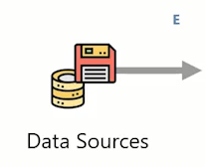

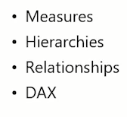
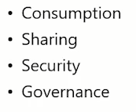
Power BI End to End Process Flow

Slide 14
3
Business Intelligent Solution

Slide 15
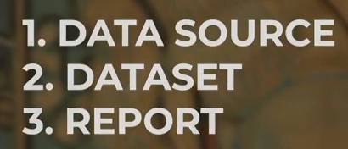
Business Intelligent Solution
Generally they have those components:

Slide 16
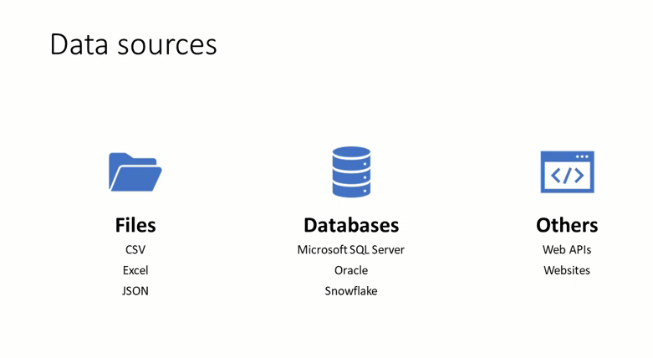
Business Intelligent Solution

Slide 17
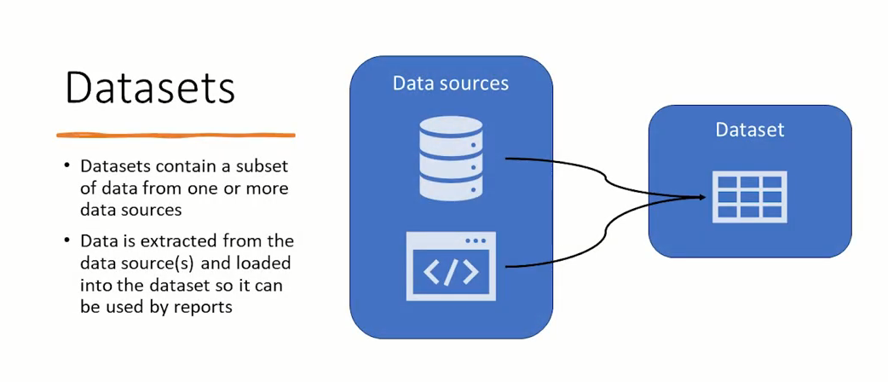
Business Intelligent Solution

Slide 18
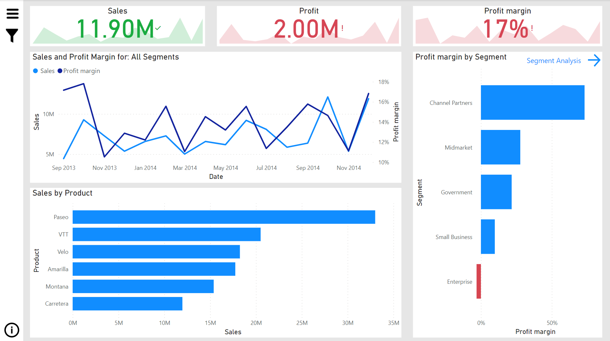
Business Intelligent Solution
Report

Slide 19
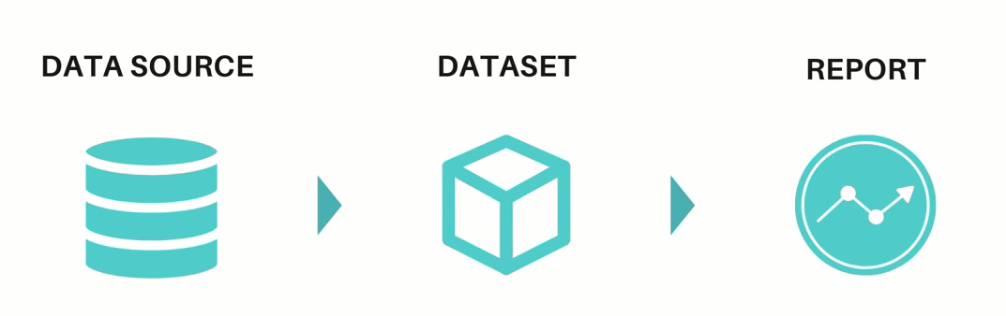
Business Intelligent Solution

Slide 20
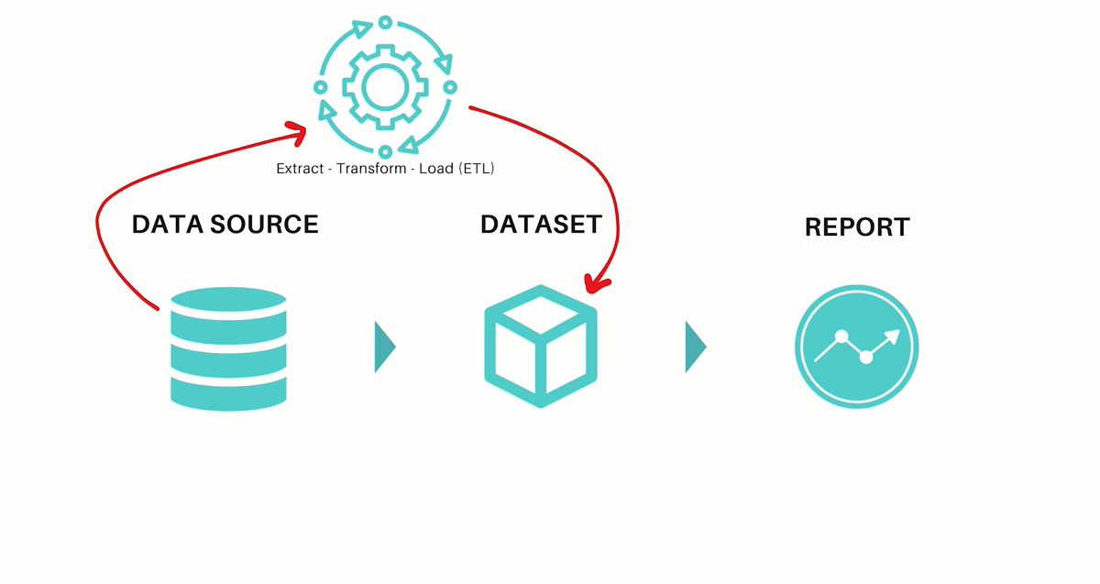
Business Intelligent Solution
Dataset can consist of one table or more

Slide 21
Business Intelligent Solution

Slide 22
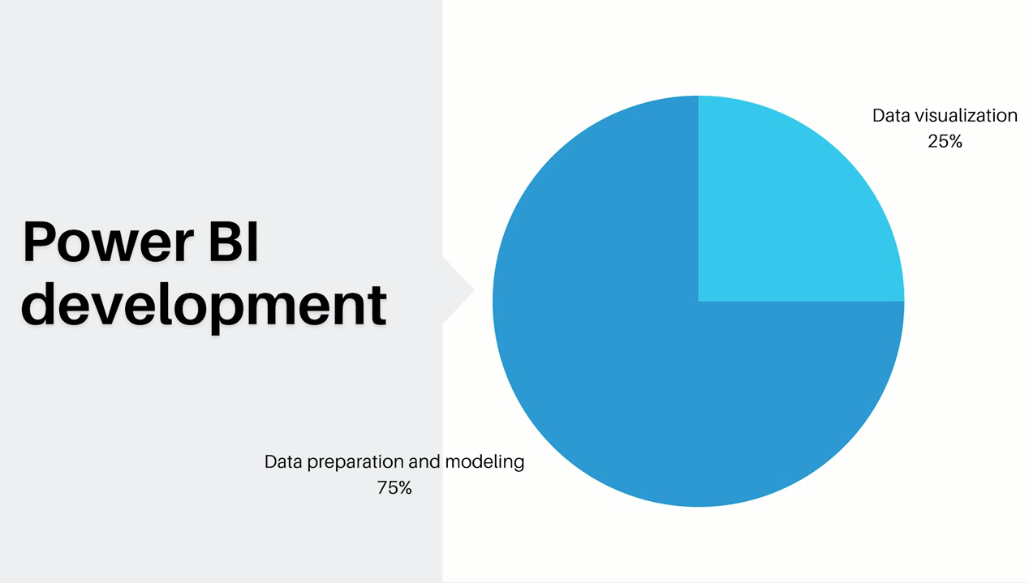

Slide 23

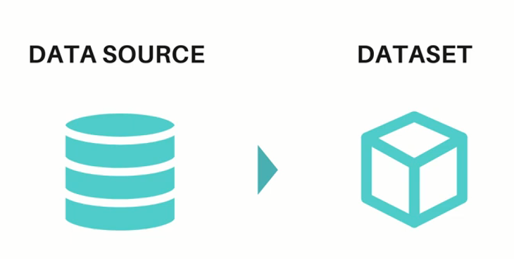
Analogy: Bake a cake and Make a Report
To bake a cake, you Fridge and Pantry your Source (Data source)
You only get what you need (Eggs , Flour ) (Dataset)

Slide 24

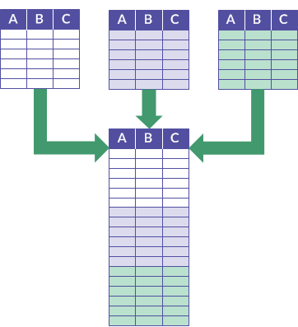

Analogy: Bake a cake and Make a Report
We want to transform our gradient
Combine and transform our data

Slide 25

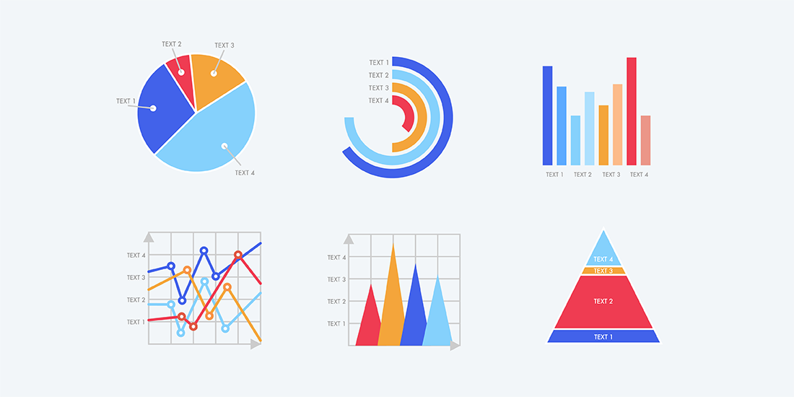
Analogy: Bake a cake and Make a Report
After oven we still have works to do
Data Visualization

Slide 26
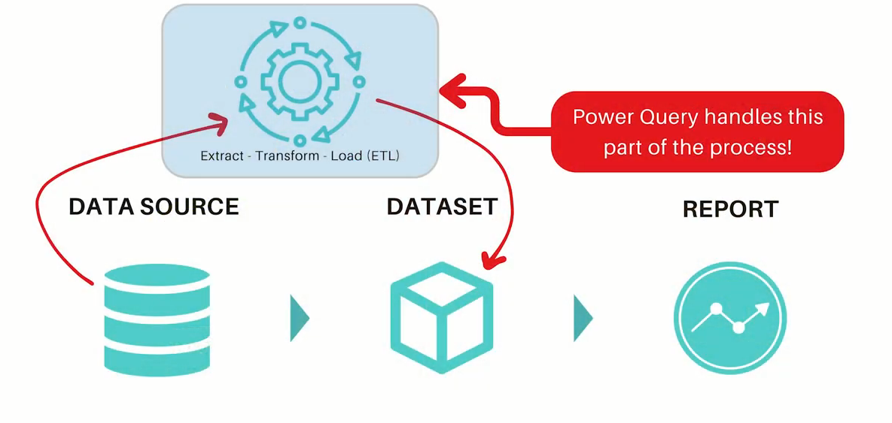

Analogy: Bake a cake and Make a Report
Power Query
Power Query
M
Language
You prepare gradients
in the Kitchen
You can find in: Excel , Power Bi ,
PowerApps , …etc.

Slide 27
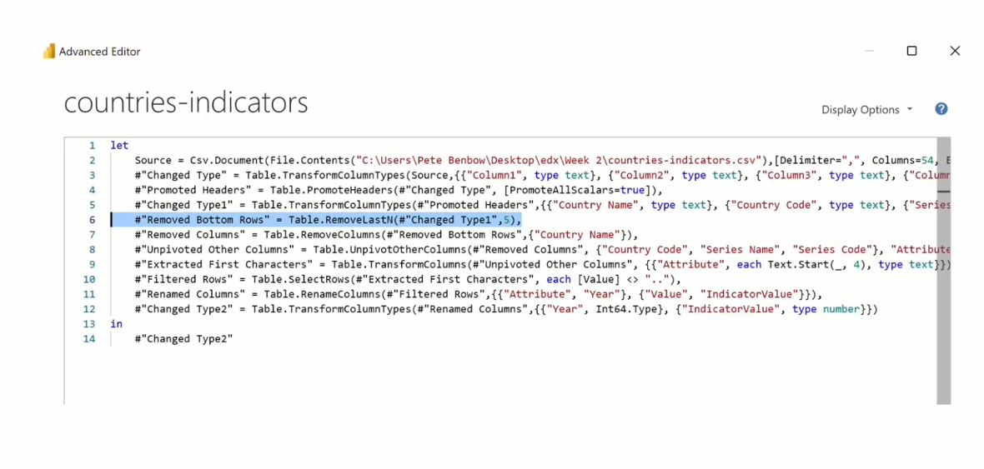
Power Query
Power Query M Language
(M Language )
The software behind is:
Power Query Mashup Engine

Slide 28
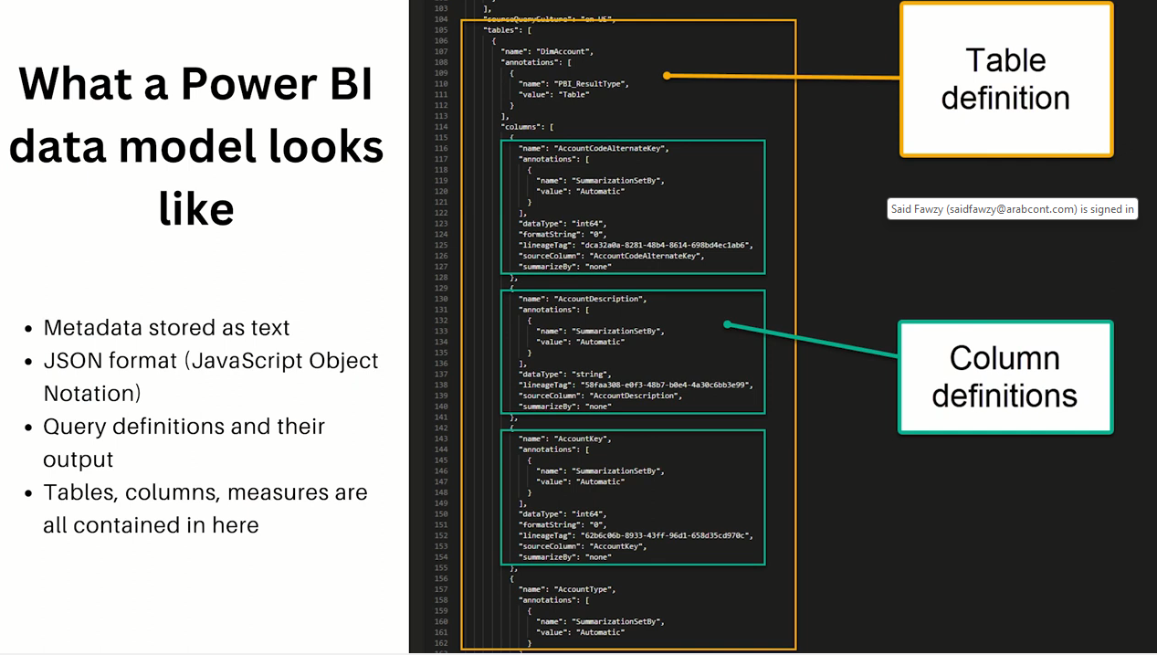
Data Model

Slide 29
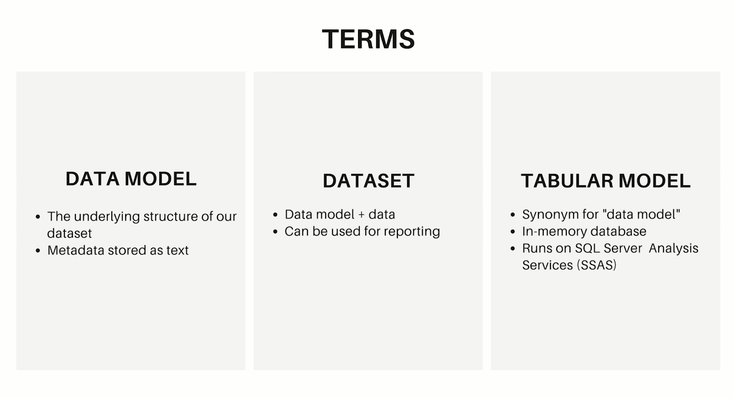

Slide 30
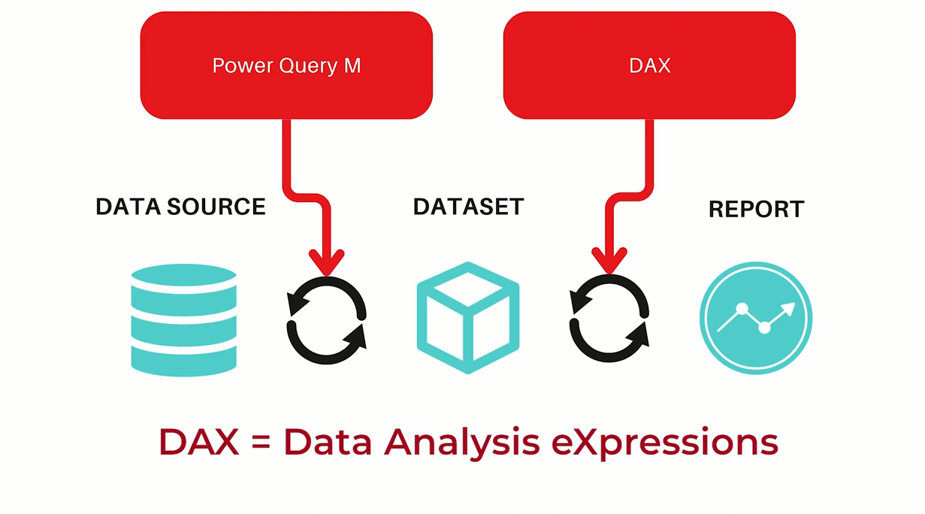
DAX

Slide 31
DAX
Dax Query

Slide 32
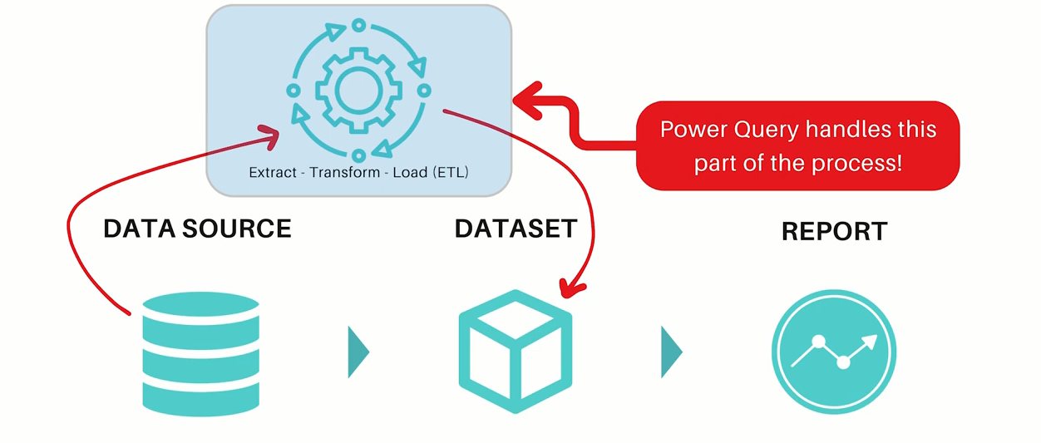
M vas DAX
M is used to extract , transform and load data
from data source to dataset

Slide 33
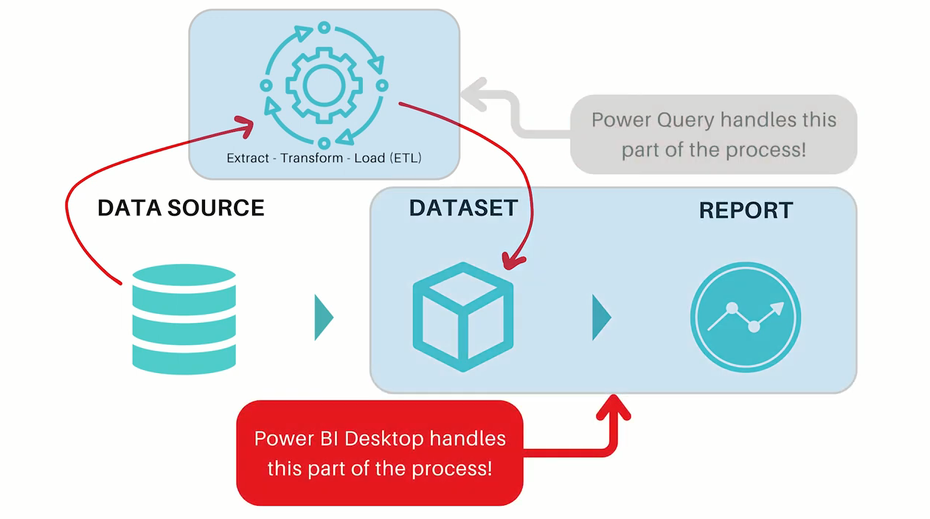
M vas DAX
Dax is used to communicate between the report
and dataset through measures and queries.

Slide 34
4
Power BI Licenses

Slide 35
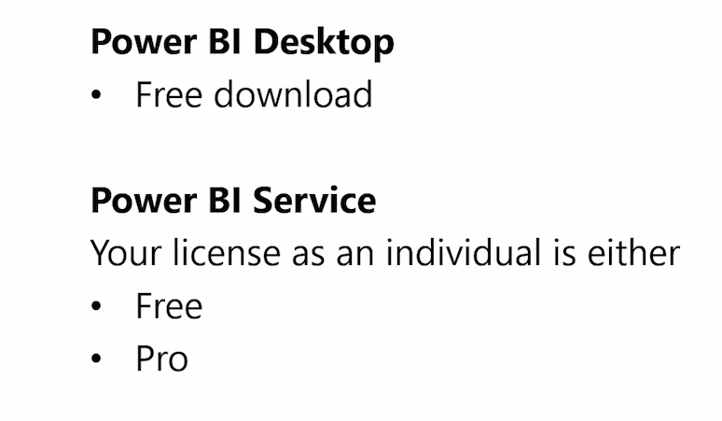
Power Bi Licenses

Slide 36
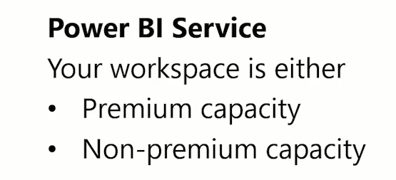
Power Bi Licenses

Slide 37
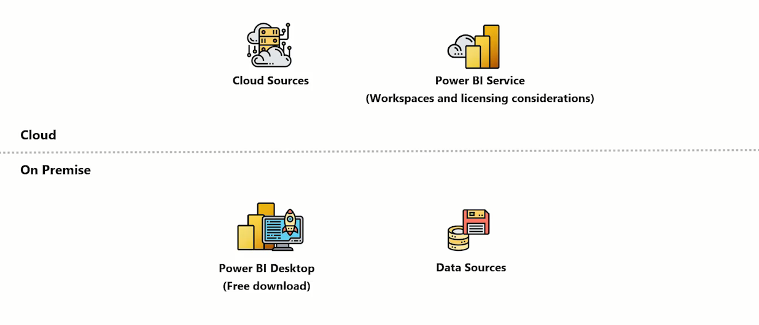
Power Bi Licenses
Publish

Slide 38
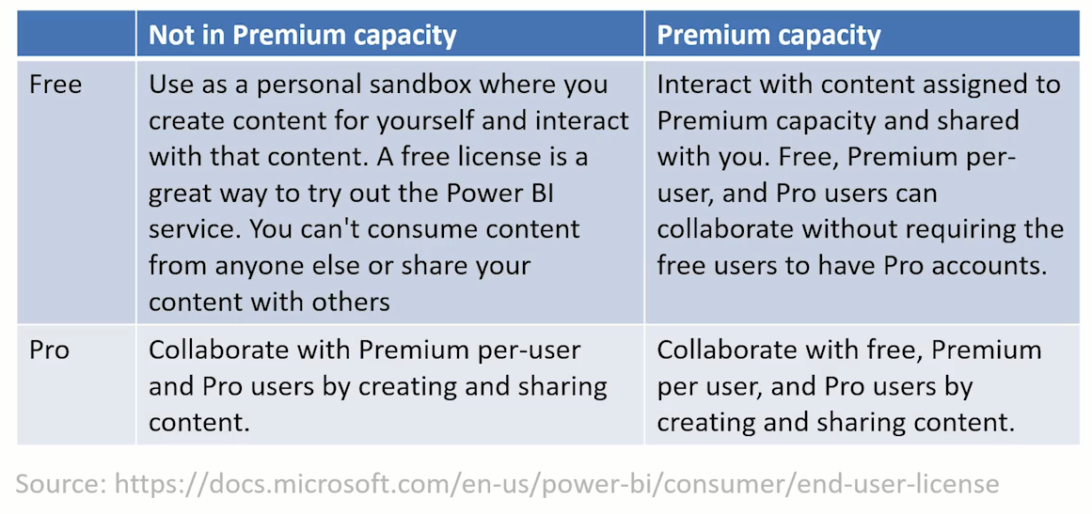
Power Bi Licenses

Slide 39
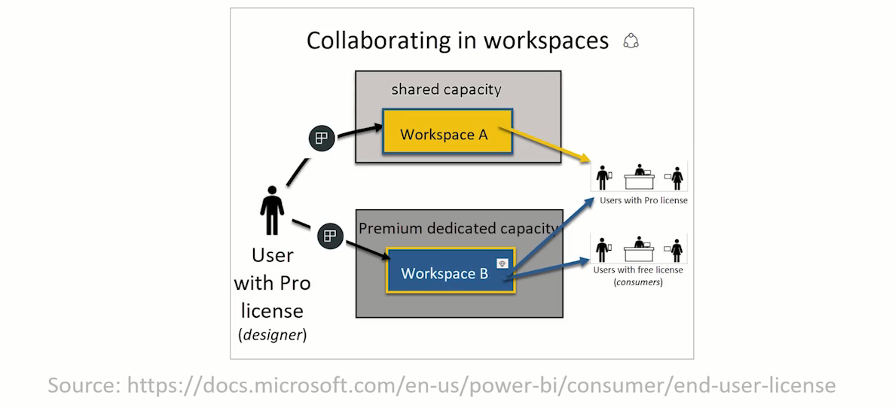
Power Bi Licenses

Slide 40
2 Download Power BI Desktop
Prepared By :
Said Fawzy
Manager of Information Center
Tendering Department
Arab Contractors

Slide 41
5
Download Power BI Desktop

Slide 42
Option 1: Power BI Site
https://powerbi.microsoft.com/en-us/downloads/
Advantage: You can apply to many computers

Slide 43
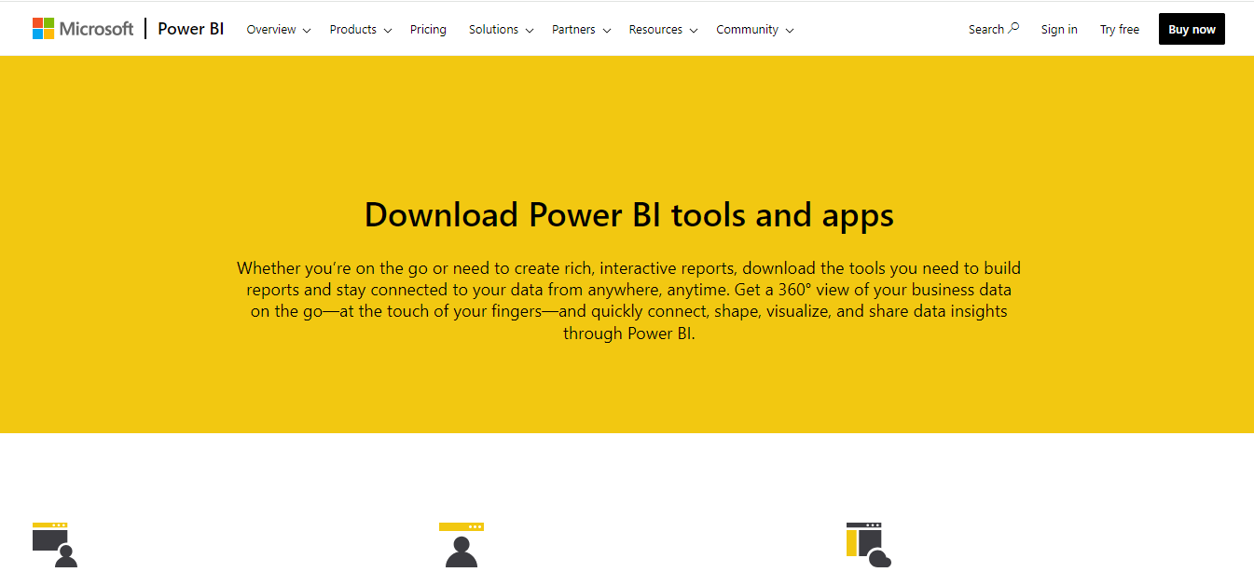
https://powerbi.microsoft.com/en-us/downloads/

Slide 44
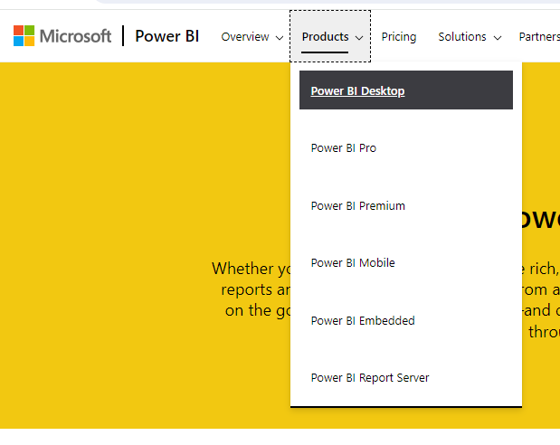

Slide 45
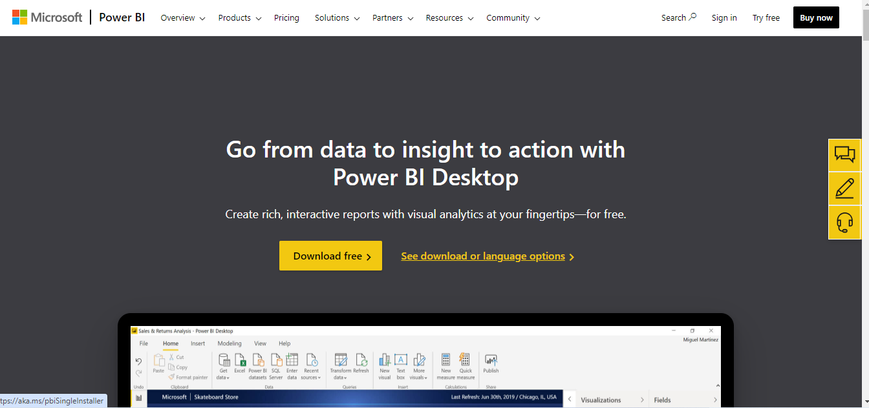

Slide 46
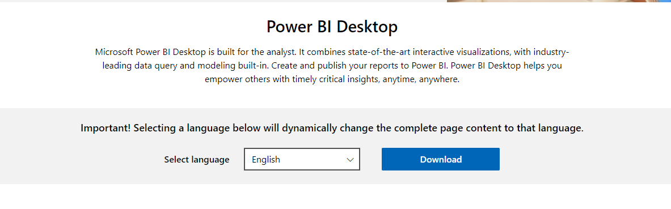

Slide 47
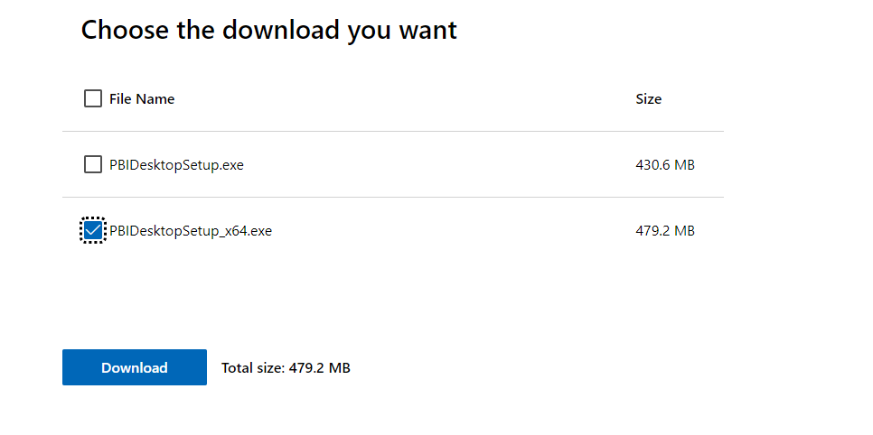

Slide 48

Option 2: Microsoft Store
Advantage: Software Updates Automatically

Slide 49
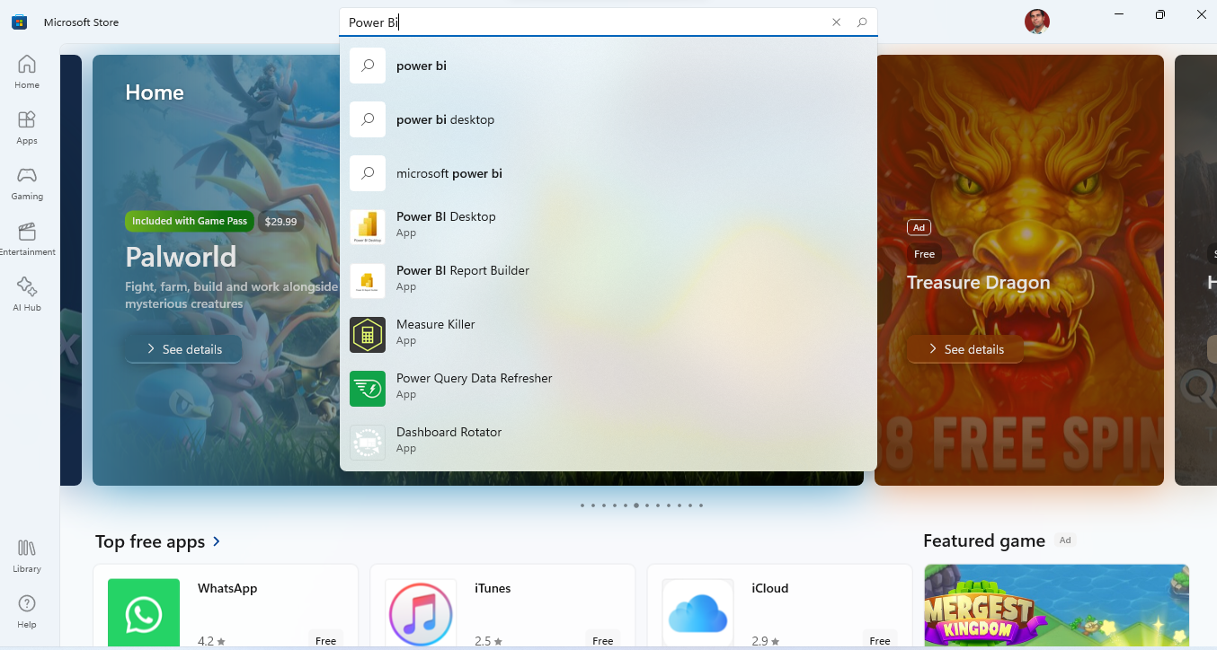

Slide 50
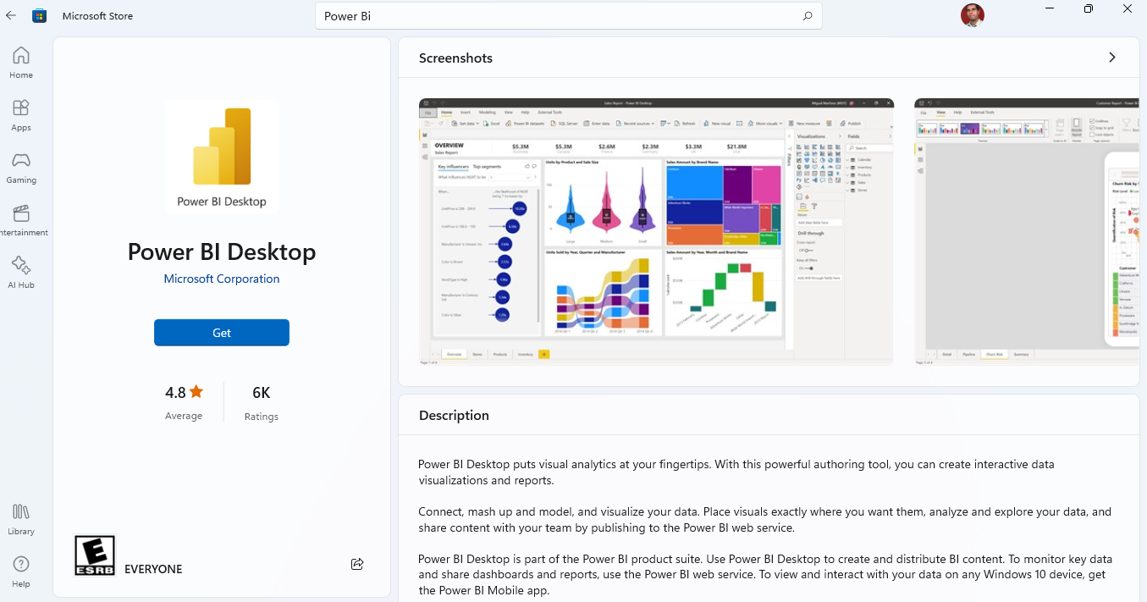

Slide 51


